Slide 1
Homeostasis Temperature control
IGCSE Biology

Slide 2
Changes in the environment
All organisms are able to respond to changes in their external and internal environments. These changes can include:
temperature
water content
pH of body fluids
concentrations of salts and other chemicals
Blood pressure
Heartbeat
Hormone levels, etc.

Slide 3
Homeostasis
Homeostasis is:
The maintenance of a constant internal environment.
This means keeping the levels of certain factors within a range of values; it is important that levels do not get too low or too high.
Homeostasis is the control of internal conditions within set limits.

Slide 4
Examples of homeostasis
Important factors controlled in the human body include:
water and salt contents of cells, blood and tissue fluid (which has been covered in Excretion)
composition of the blood – especially the concentration of glucose
temperature.

Slide 5
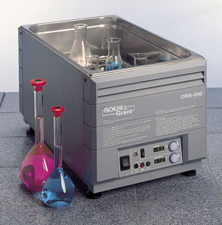
Water Bath
Thermostat/ thermostatically controlled water bath:
a regulator for automatically regulating temperature by starting or stopping the supply of heat.
Our body acts just like this in temperature control.

Slide 6
Temperature control
Endothermic V.S. Ectothermic
Q: What organs are crucial in human body temperature control?
Q: How do your body know you need to take actions to increase or decrease your body temperature?

Slide 7
Temperature control
Changes in body temperature are detected by receptors in the hypothalamus, which is a part of the brain.
The hypothalamus coordinates the activities of the parts of the body that bring about temperature changes.

Slide 8
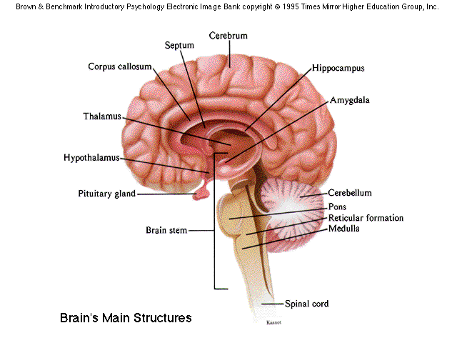
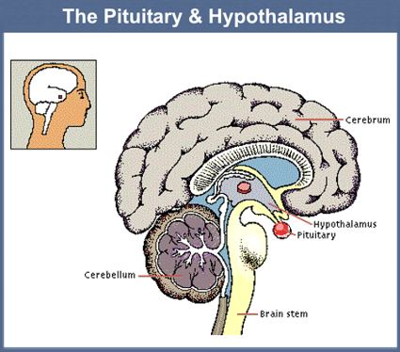
Temperature control

Slide 9
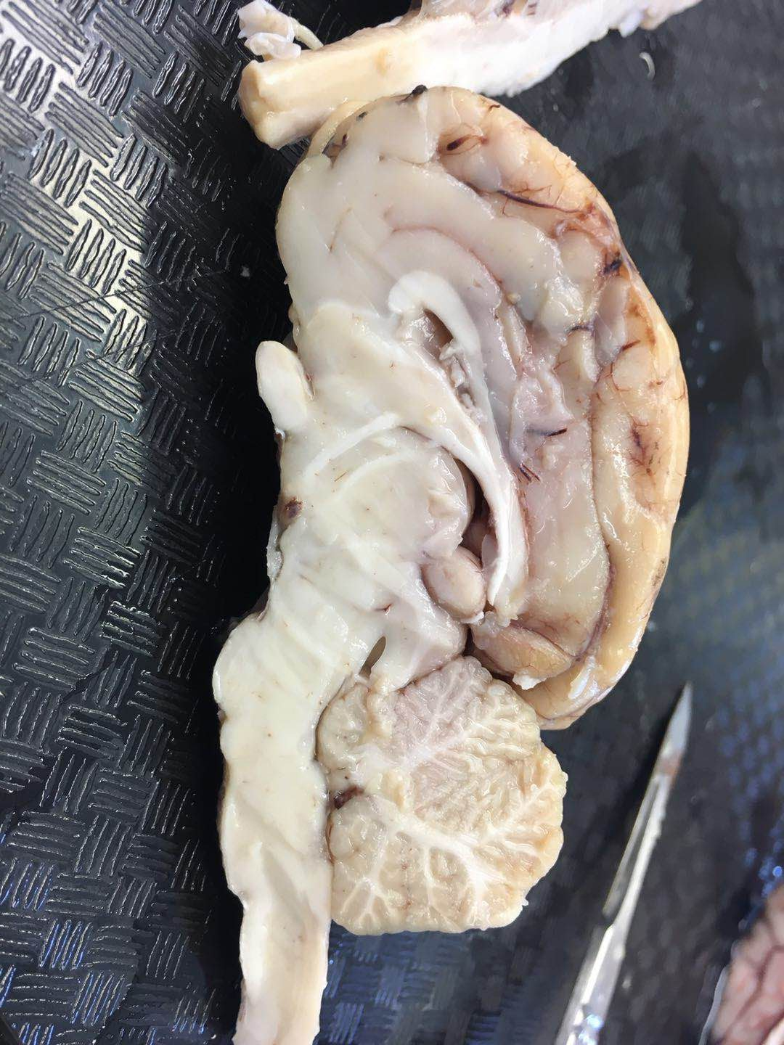
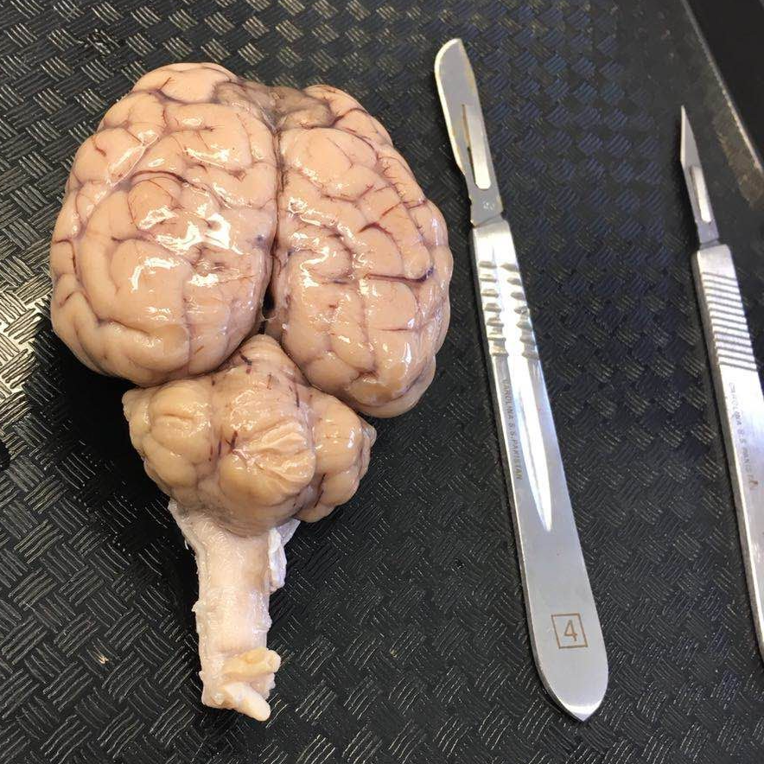

Slide 10
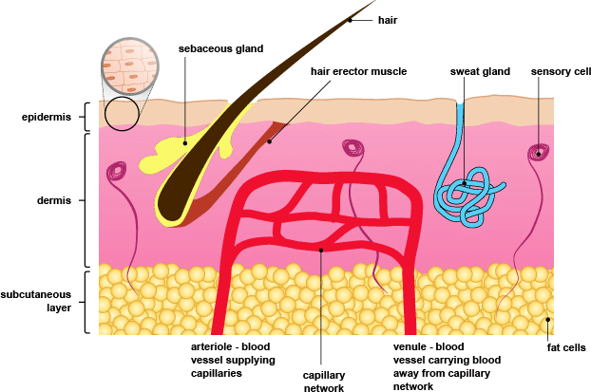
Skin structure
Produces sweat
The fatty (adipose) tissue under the skin surface helps to insulate the body to reduce heat loss.

Slide 11
Skin structure

Slide 12
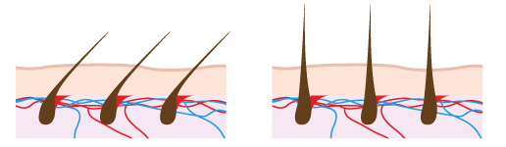
Temperature control - hair
https://www.centracare.com/blog/2016/january/top-5-ways-body-heat-is-lost/
In hot conditions:
In cold conditions:
Hair erector muscles relax.
Hairs lie flat against the skin.
More heat is lost by radiation (one of the four ways of losing heat/ heat exchange, the other three being convection, conduction, evaporation).
Hair erector muscles contract.
Hairs are pulled upright and trap a layer of air.
Less heat is lost by radiation.
Notes:
In physics, radiation is the emission or transmission of energy in the form of waves or particles through space or through a material medium.
This includes:
electromagnetic radiation, such as radio waves, microwaves, infrared, visible light, ultraviolet, x-rays, and gamma radiation (γ)
particle radiation, such as alpha radiation (α), beta radiation (β),proton radiation and neutron radiation (particles of non-zero rest energy)
and so on.

Slide 13

Body heat loss
https://www.ncbi.nlm.nih.gov/books/NBK541107/
Heat loss occurs through four mechanisms: evaporation, convection, conduction, and radiation.
The heat generated by the core body tissues travels to the vasodilated skin surface capillaries, and the temperature gradient between the limbs and environment drives transfer of heat to the surrounding air, mainly by radiation. Radiation is the most significant source accounting for approximately 60% of heat loss.
Core body tissues transfer heat in subcutaneous blood vessels which emit infrared rays from the skin surface to lose heat by radiation.
Evaporation is the next major source accounting for about 22% of heat loss. This process occurs even when the body is not sweating.
Finally, conduction and convection contribute roughly 15% of heat loss.
Conduction is the loss of molecular kinetic energy in the form of heat from the skin to the surroundings. Different mediums transfer heat by conduction at different rates. For example, the conductive transfer of water is 100 times that of air.
Radiation and conduction can facilitate heat loss as long as skin temperature is greater than the surroundings.
Notes:
At extremely high skin temperature (over 43°C), evaporation is the only mechanism of heat dissipation (???).

Slide 14
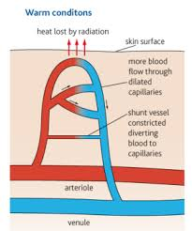
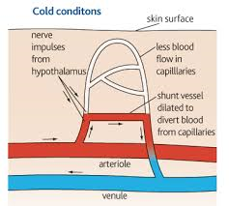
Temperature control – blood vessels
Vasodilation and vasoconstriction, are of arterioles supplying skin surface capillaries
When we get too hot:
Vasodilation, means arterioles that supply skin surface capillaries dilate, allowing more blood to flow closer to the skin surface
sweat glands produce sweat
hairs lie flat
more heat is lost.
When we get too cold:
Vasoconstriction, means arterioles that supply skin surface capillaries constrict, so less blood flow close to the skin surface
sweat glands stop producing sweat
hairs stick up
less heat is lost.
Generate more heat by shivering – muscular activity (rapid contraction and relaxation)

